Slide 1

Early Learning Network
Year 1 Results:
Preschool Educational Practices and
Child Outcomes
The Early Learning Network is funded by the Institute of Education Sciences.
Society for Research on Educational Effectiveness
February 28, 2018
  @earlylearnnet

Slide 2
The Early Learning Network aims to advance the understanding of policies and practices that narrow the achievement gap and maintain early learning success as children transition from preschool to elementary school and beyond.

Slide 3

♦ Five Research Teams
♦ One Assessment Team
♦ Network Lead

Slide 4
Complementary Research Studies
Descriptive study:
  Identify systems-level policies and practices that support early learning
Classroom observation study:
  Identify teaching practices and other classroom-level malleable factors associated with children’s school readiness and achievement in preschool and early elementary school
Longitudinal study:
  Identify malleable factors associated with early learning and school achievement over time from preschool through the early elementary school grades

Slide 5
Symposium Agenda
Paper 1: Pre-Kindergarten Classroom Characteristics and Pre-Kindergarten Gains of Children Living in Rural Areas
  University of North Carolina – Chapel Hill (Irina Mokrova, Margaret Burchinal, Mary Bratsch-Hines, & Ellen Peisner-Feinberg)
Paper 2: How Does Quality of Curricular Implementation Support Diverse Children’s Skills in Pre-Kindergarten? Evidence from Boston
  MDRC/University of Michigan (Meghan McCormick, Michelle Maier, Christina Weiland, JoAnn Hsueh, Jason Sachs, & Catherine Snow)
Paper 3: Understanding the Effects of Classroom Processes on Child Outcomes in Pre-Kindergarten
  University of Virginia (Robert Pianta, Jessica Whittaker, Virginia Vitiello, Erik Ruzek, Arya Ansari, & Tara Hofkens)
Paper 4: Classroom Quality and Classroom Network Structure Predicting Student Outcomes
  Ohio State University (Jessica Logan Kelly Purtell, Tzu-Jung Lin, & Laura Justice)
Discussant
  Carol Connor (University of California-Irvine)

Slide 6
Pre-K classroom characteristics and Pre-K gains of children living in rural areas
Irina Mokrova
Peg Burchinal
Mary Bratsch-Hines
Ellen Peisner-Feinberg
University of North Carolina at Chapel Hill

Slide 7
Educational practices and child outcomes in Pre-K
ECE can reduce achievement gap
State and federal pre-kindergarten (Pre-K) programs
But – questions remain:
  which dimensions of ECE experiences relate to which Pre-K skills

Slide 8
ECE quality dimensions
Process quality
  Widely examined; modest associations
Verbal interactions with adults
  Associations with language and literacy skills
  Basis for teacher scaffolding
Instruction time
Setting
  Small groups help young children learn
Curriculum
    Wide-scale belief in whole child curricula
    Evidence for domain-specific curricula
Notes:
Define Process quality

Slide 9
Types of child early academic and cognitive skills
Academic skills
  Increasing attention in Pre-K classrooms
      Phonemic skills and letter-word recognition
      Early numeracy
Cognitive skills
  Higher-order cognitive skills
      Language
      Executive functioning

Slide 10
Specific Classroom Practices Predict Specific Outcomes?
Domain specificity
    Instruction time in that domain
    Use of domain-specific curriculum
Academic skills related to
    Classroom process quality
    Small group settings
Cognitive skills related to
    Classroom process quality
    Complex conversations with teacher
    Small group settings
Notes:
Define domain specificity

Slide 11
Design and participants
Cohort study of rural NC
  6 NC rural counties
  63 randomly selected NC Pre-K classrooms
Pre-K children
  351randomly selected children
    34% Spanish-English dual language learners
Classroom quality, observed 2 days
  CLASS
  Boston Pre-K “fidelity” checklist
  Language Interactions Snapshot (LISn)
  Teacher report of curriculum

Slide 12
Classroom Quality
Factor analysis of classroom observation measures
  1. Process Quality
    CLASS Domains - ES, CO, IS
    Boston pre-K “fidelity” checklist
  2. Complex conversations with adults - LISn
    any adult elicited, elaborated, and had sustained conversation
  3. Instruction – LISn
    Literacy activities (print, writing, sound)
    Math activities

Slide 13
Classroom Quality
  4. Curriculum: teacher report
    Creative Curriculum used in 78% classrooms
  5. Setting: LISn
    large group
    small group

Slide 14
Correlations among Quality Dimensions
 | Process Quality | Complexconver-sation | Literacy Activities | Sounds Activities | Math Activities | Small Group | Whole Group | Creative Curric.
Process quality |  | .27* | .16 | -.04 | .13 | -.10 | .25* | .20
Complexconver-sation |  |  | .34** | .24+ | .47*** | .35** | .07 | -.18
Literacy Activities |  |  |  | .63*** | .05 | .01 | .21+ | -.24+
Sounds Activities |  |  |  |  | .12 | .00 | .05 | -.37**
Math Activities |  |  |  |  |  | .50*** | .06 | -.34**
Small group |  |  |  |  |  |  | -.27* | -.24+
Whole group |  |  |  |  |  |  |  | -.13

Slide 15
Child Outcomes
Children assessed fall and spring – gain scores
Academic skills
  Literacy
    WJ Letter-word ID
    DIBELS First sound fluency
    DIBELS Phonemic fluency
  Numeracy
    WJ Applied problems
Cognitive skills
  Language
    Expressive One Word (English and Spanish)
    WJ Picture vocabulary
  Executive function
    Inhibitory control (Flanker)
    Cognitive Flexibility (Card sort)

Slide 16
HLMs:
Backward Elimination Process
Children nested in classrooms
First model: All quality dimensions and controls
Subsequent models: Taking out quality dimensions one at a time
Reduced model: One or more dimensions became significant

Slide 17
HLM Results, Reduced models
 | Letter-Word ID | Applied Problems | 1st Sound Fluency | Phoneme Fluency | Picture Vocab | EOW English | EOW Span. | Inhibitory Control | Cognitive Flexibility
Process Quality | .23***
Complex Conversation |  |  |  |  |  |  | .18*
Literacy Activities |  |  |  |  |  | .26**
Math Activities
Sound Activities |  |  | .16** | .14*
Small Group Setting |  |  |  |  |  |  |  |  | .14*
Whole Group |  | -.13* |  |  |  | -.17*
Creative curriculum | -.21*** |  |  |  |  |  |  | -.14*
n | 351 | 349 | 350 | 349 | 334 | 240 | 103 | 273 | 227

Slide 18
Conclusions
All but one outcome related to at least one quality dimension
  No clear pattern
    Most outcomes related to a single dimension
    No single quality dimension dominated
Predictors of academic skills are not clearly different from cognitive skills

Slide 19
Take-away message
Focus on other dimensions in addition to process quality may be warranted
  Time in content-related instruction
  Type of setting
  Language as a tool for scaffolding
Whole child curriculum negatively related to some academic or cognitive gains
  Scaffolding needs to be a process behind any curriculum

Slide 20
Our appreciation
To all participating families, teachers, and school administrators
To all research assistants and project staff
To the Institute of Education Sciences

Slide 21
How Does Quality of Curricular Implementation Support Diverse Children’s Skills in Prekindergarten?:
Evidence from Boston
Meghan McCormick
Michelle Maier
Christina Weiland
JoAnn Hsueh
Jason Sachs
Catherine Snow
February 28th, 2018
2018 Society for Research on Educational Effectiveness
Washington, DC

Slide 22
Current issues in the field of early education
Mixed evaluation results
Some evaluations demonstrate large to moderate impacts of PreK while others show null effects.
Role of implement-ation
Combination of intended pedagogy, content, instructional activities and practices thought to shape child outcomes
Assessing fidelity in the field
Tool to assess implementation fidelity can break apart components to understand whether, how, and for whom fidelity links to child outcomes.

Slide 23
The BPS Model as a Case Study for Examining Fidelity of Implementation
Curriculum in place | Example components adapted from OWL | Example Building Blocks components | Example district-developed components
Focus on K1 (district-adapted version of Opening the World of Learning & Building Blocks). Thematic curriculum that cuts across ELA, math, science, social study, and arts. | Centers & Introduction to Centers | Building Blocks centers | Thinking & feedback
 | Read Aloud | Building Blocks whole group activities | Storytelling
 | Small Groups to support language/literacy | Building Blocks small group activities | Storyacting

Slide 24
Research questions
What does fidelity look like across prekindergarten public school classrooms in BPS?
  Does fidelity vary systematically by classroom composition?
What measures of fidelity are most closely associated with CLASS?
Is fidelity to the BPS PreK model associated with children’s language and math scores in the Spring of PreK?
  For which groups of students does fidelity appear most predictive of Spring outcomes (e.g., dual language learners, racial/ethnic minority students)?

Slide 25
Schools participating in study
(N = 20 public schools with prekindergarten program)
School-level characteristic | % for study schools | % for school district
School structure: PreK – 5th grade | 30% | 50%
School structure: PreK – 1st grade | 5% | 8%
School structure: PreK – 8th grade | 55% | 32%
% Students economically disadvantaged | 48.38% | 51.05%
% Students Black | 25.59% | 31.60%
% Students White | 15.70% | 16.17%
% Students Hispanic | 46.43% | 42.37%
% Students Asian | 8.50% | 5.99%
% Students whose first language is not English | 49.15% | 41.90%
% Met or exceeded expectations on 2015 – 2016 ELA exam | 39.74% | 35.95%
% Met or exceeded expectations on 2015 – 2016 math exam | 44.47% | 41.48%

Slide 26
Classroom & teacher participants
(N = 41 public school classrooms across 20 schools)
Teacher characteristic | %age/Mean
Teacher age | 43.95 (SD = 9.37)
Years teaching | 14.79 (SD = 9.25)
Years teaching prekindergarten | 8.6 (SD = 7.37)
Years teaching at current school | 7.79 (SD = 8.01)
Teacher has master’s degree | 90%
Teacher female | 100%
Teacher Black | 22%
Teacher White | 49%
Teacher Hispanic | 13%
Teacher Asian or other race | 16%
Classrooms per school | 1.35 (SD = .42)

Slide 27
Student sample
(N = 299 BPS prekindergarten students)

Slide 28
Research & BPS teams Co-construct Tool to Measure Fidelity of Implementation
Research team conducts in-depth curriculum review and meets with BPS staff
Further edits and adaptation following field-based piloting with BPS staff
Training and reliability procedures take into account BPS staff feedback
Research team develops fidelity tool and iteratively edits it following meetings with BPS staff
BPS instructional coaches collect data in classrooms

Slide 29
Fidelity Data in Public School Classrooms
N = 41 classrooms in 20 schools
41 total public prekindergarten classrooms participated (97% of teachers in participating schools)
Classrooms observed 2x
Each classroom observed on two separate days for 2 – 3 hours/obs. Observation data averaged across days.
Reliability
20% of observational visits were coded by two BPS coaches; Reliability analysis suggests high agreement.

Slide 30
Procedure (thus far) for analyzing fidelity data
Examine dosage, adherence, and quality of implementation
Examine fidelity scores within curriculum components
Consider variation within and across components
In order to make fidelity relevant to district - create measures that cut across components and operationalize core practices that are central to curriculum

Slide 31
Cross-component fidelity measures
Vocabulary
(α = .91)
Extending/Building
(α = .91)
Summary/ Reflection/Making Connections
(α = .79)
Scaffolding/ Differentiation
(α = .82)

Slide 32
What does fidelity look like overall in BPS public school prekindergarten classrooms?

Slide 33
How does this compare to CLASS scores?

Slide 34
How does implementation vary depending on classroom composition?
There are some differences in implementation between classrooms. On average:
  Classrooms with higher percentages of white students have higher quality of implementation
  Classrooms with higher percentages of black and Hispanic students have lower quality of implementation
  Classrooms with higher percentages of DLLs have similar quality of implementation as classrooms with fewer DLLs, but more variation across classrooms.

Slide 35
Example of variation in fidelity by classroom composition: Eligibility for free/reduced price lunch

Slide 36
How do fidelity measures relate with CLASS?
 | Instructional support | Emotional support | Classroom org.
Instructional support | 1.0
Emotional support | .67 | 1.0
Classroom org. | .69 | .85 | 1.0
Extending/Building | .18 | .16 | .10
Summary/Reflection | .22 | .10 | .14
Vocabulary | .01 | .01 | -.07
Scaffolding/Differentiation | .35 | .21 | .22

Slide 37
Is fidelity associated with children’s language/math skills in the Spring of PreK?: Some preliminary findings
Two-level models with classroom-level random intercepts.
Outcomes:
  PPVT assessed in the Spring of 2017
  Woodock Johnson Applied Problems (5% of sample tested in Spanish) from Spring 2017
Covariates: Fall 2016 level of the outcome, child race (white reference group), FRPL eligibility, DLL status, female, child age, CLASS domains
Interactions used to test how associations vary by race/ethnicity, FRPL, and DLL status

Slide 38
Student math skills across the prekindergarten year

Slide 39
Links between fidelity of implementation and improvements in language and math across prekindergarten year
Full sample of students - no significant associations between cross-component fidelity measures and gains in language or math across prekindergarten year
No significant associations detected in this preliminary work using cross-component fidelity constructs to predict PPVT outcomes
Statistically significant interactions between fidelity of implementation, Hispanic and DLL status, and math outcome

Slide 40
Example of Predicted Math Skills for Hispanic Students at End of Prekindergarten Year

Slide 41
Example of Predicted Math Skills for White Students at End of Prekindergarten Year

Slide 42
Example of Predicted Math Skills for Dual Language Learner Students at End of Prekindergarten Year

Slide 43
Limitations & Next Steps
Work is very preliminary and in early stages
  Future models will include more rigorous work to determine covariates and alternative model fits.
More measurement work needed to operationalize fidelity constructs and consider any within-component measures of adherence, dosage, quality
Data are correlational across one school year
Sample is fairly small in Year 1 study (particularly for subgroups); future years will include larger samples for subgroup examination

Slide 44
Some preliminary conclusions
Reliable fidelity data can be collected by district staff.
Systematic variation in fidelity across classrooms.
Fidelity may predict math outcomes (on a small magnitude) but story is likely in the subgroups for a diverse sample with varying skill levels at baseline and follow-up.

Slide 45
Acknowledgments
MDRC
Marissa Strassberger
Rama Hagos
Sharon Huang
Jared Smith
Desiree Alderson
Ilana Blum
Kelly Terlizzi
Mirjana Pralica
BPS
Brian Gold
Abby Morales
Marina Boni
Melissa Luc
David Ramsey
BPS Dept. of Early Childhood Staff
University of Michigan
Deborah Ball
Lillie Moffett
Paola Rosado
Amanda Ketner
Harvard
Nonie Lesaux
Sibyl Holland
Maia Gokhale
Data collection team

Slide 46
Funding Acknowledgment
The research reported here was supported by the Institute of Education Sciences, Department of Education, through Grant R305N160018 – 17 to MDRC.
The opinions expressed are those of the authors and do not represent views of the Institute or U.S. Department of Education.

Slide 47
Questions?
Meghan McCormick
MDRC
meghan.mccormick@mdrc.org
Michelle Maier
MDRC
meghan.mccormick@mdrc.org
Christina Weiland
University of Michigan
weilandc@umich.edu
JoAnn Hsueh
MDRC
joann.hsueh@mdrc.org
Jason Sachs
Boston Public Schools
jsachs@bostonpublicschools.org
Catherine Snow
Harvard Graduate School of Education
Catherine_snow@gse.harvard.edu

Slide 48

Understanding the effects of classroom processes
on child outcomes in pre-kindergarten
Robert C. Pianta, PhD
February 28, 2018

Slide 49
Research Team
Robert Pianta
Jessica Whittaker
Ginny Vitiello
Erik Ruzek
Marcia Kraft-Sayer
Brittany Kerr
Laura Helferstay
Marianna Lyulchenko
Arya Ansari
Tara Hofkens
Partners: School district, IES, ELN

Slide 50
FP3 – Pre-K Year Early Results
Sample information
Descriptions of classroom practices and opportunity
Early results from outcome analyses

Slide 51
Study Context
Large county in urban ring
Economically, ethnically, racially, linguistically diverse
15+ years experience operating two pre-k program types
  Programs for 4-year-olds in public schools, run by schools
  Programs operated in community-based centers, including HS and community child care
Experienced teaching staff
    Mean years of education: 16.8
    39% have a major in EC
    Mean years teaching experience: 15.6
    43% of teaching staff non-white

Slide 52
Pre-k – K Procedures
Recruited teachers, schools, families
Assess children’s skills fall and spring
Observe classrooms
Recruit all eligible children in any pre-k classroom with more than five such children
Teachers/classrooms enrolled: 115
Children/families enrolled: 1,575
Exclude children with IEPs

Slide 53
Children’s Race/Ethnicity

Slide 54
Primary Language Spoken at Home

Slide 55
Characteristics by Program
 | Public School Pre-K | Community-Based
 | Mean/Percent | Mean/Percent
Hispanic | 16% | 26%
Black | 55% | 52%
Asian American | 11% | 5%
Mixed Race | 4% | 9%
Other Race | 4% | 2%
English Language | 18% | 34%
Spanish Language | 56% | 47%
Other Language | 26% | 19%
Percent LEP | 71% | 24%
Income/Needs | 0.84 | 0.97

Slide 56
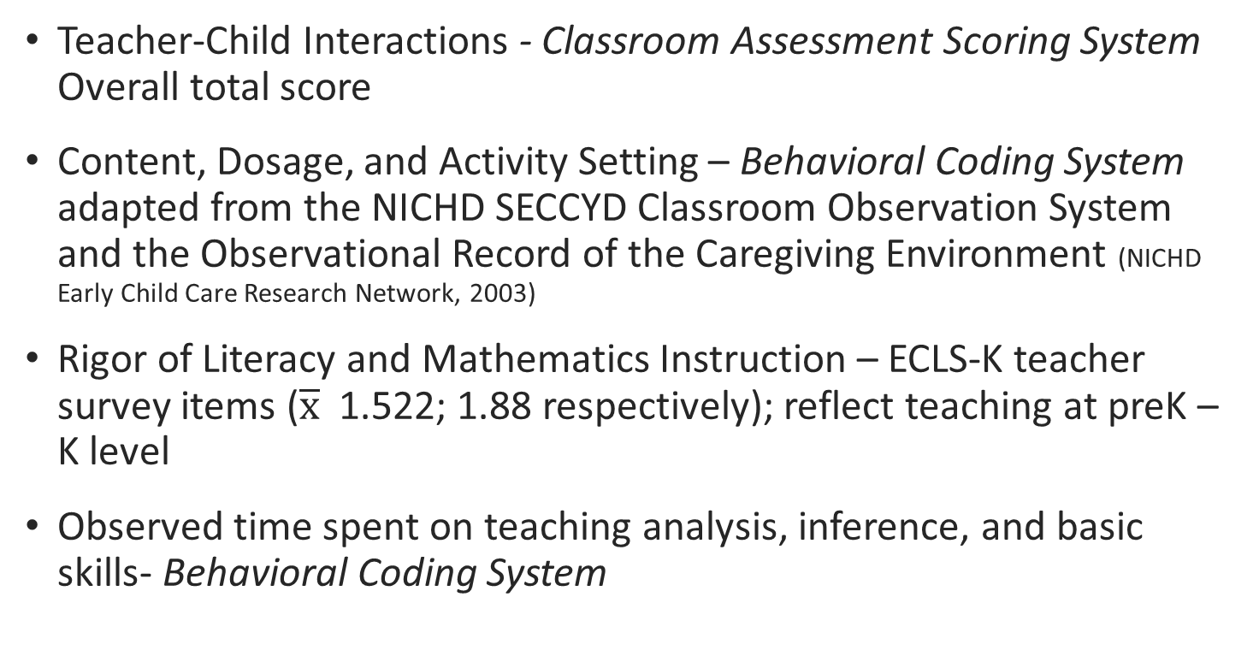
Classroom Observations
Teacher-Child Interactions - Classroom Assessment Scoring System Overall total score
Content, Dosage, and Activity Setting – Behavioral Coding System adapted from the NICHD SECCYD Classroom Observation System and the Observational Record of the Caregiving Environment (NICHD Early Child Care Research Network, 2003)
Rigor of Literacy and Mathematics Instruction – ECLS-K teacher survey items ($\overline{x}$ 1.522; 1.88 respectively); reflect teaching at preK – K level
Observed time spent on teaching analysis, inference, and basic skills- Behavioral Coding System

Slide 57

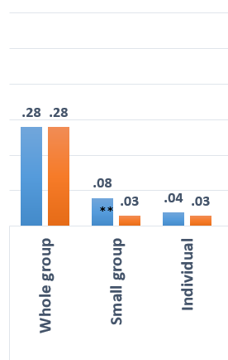
Activity Settings in Public Pre-K Programs
Notes. ** p < .01

Slide 58
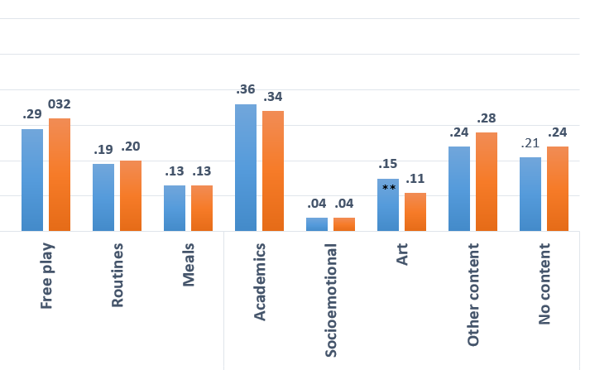
Activities in Public Pre-K Programs
Notes. ** p < .01

Slide 59

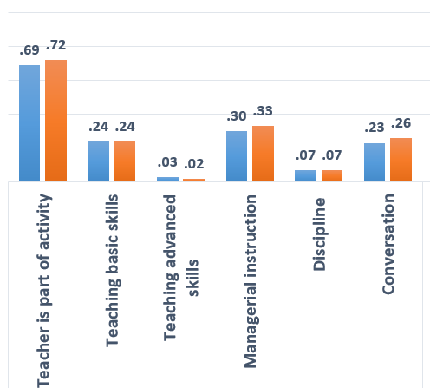
Teacher Behavior in Public Pre-K Programs

Slide 60
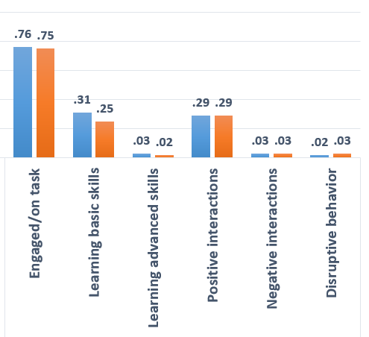
Child Behavior in Public Pre-K Programs

Slide 61
Differences in Classroom Process and Practices in Public Pre-K Programs
Very few differences emerged in the classroom processes across public and community-based programs
  Community programs spent less time in small group and art
Few teacher and classroom characteristics were predictive of classroom processes, but:
  More educated and experienced teachers spent more time teaching and in teacher-directed instruction (+5-6% of the day)
  Teachers’ adult centered beliefs were associated with greater time spent in managerial instruction (+6% of the day)

Slide 62
Are malleable classroom factors (teacher-child interactions, instructional content and dosage of instruction, activity setting, and rigor of instruction) positively associated with changes in the quality of children’s relationships with teachers, social skills, and executive function skills over the pre-k year?

Slide 63
Measures – Child Outcomes
Teacher-Child Relationships – Student Teacher Relationship Scale (Pianta, 2001)
Social Skills and Conduct Problems – Teacher Child Rating Scale (Hightower et al., 1986)
Executive Function
  Head, Toes, Knees, Shoulders (McClelland et al., 2007)
  Pencil Tap (Smith-Donald, Raver, Hayes, & Richardson, 2007)
  Backward Digit Span
  Woodcock Johnson – Literacy (2), Math (2) subtests

Slide 64
Analyses
Hierarchical linear models (nesting students in classrooms)
Models control for:
- Baseline measure of each outcome in the fall
Student characteristics (gender, age, race/ethnicity, SES, language)
Classroom characteristics (aggregated student gender, age, race/ethnicity, income, special needs,
Teacher characteristics (race, education, experience, beliefs about children)
Program type

Slide 65
Teacher-Child Relationships
 |  | Closeness |  |  | Conflict
 |  | Estimate | p | S.E. | Estimate | p | S.E.
Fall Pretest |  | .675 | *** | .026 | .715 | *** | .020
Teacher-Child Interactions | Overall Quality |  |  |  | -0.38 | ** | 0.11
Content Dosage | Proportion Academics
 | Proportion SEL
Activity Setting | Proportion Teacher-Structured
 | Proportion Routines
Rigor | Literacy Level
 | Math Level
*p<.10, **p<.05, ***p<.01

Slide 66
Social and Emotional Skills
 |  | Task Orientation |  |  | Social Skills |  |  | Conduct Problems
 |  | Estimate | p | S.E. | Estimate | p | S.E. | Estimate | p | S.E.
Fall Pretest |  | .726 | *** | .018 | .714 | *** | .025 | .728 | *** | .023
Teacher-Child Interactions | Overall Quality
Content Dosage | Proportion Academics
 | Proportion SEL
Activity Setting | Proportion Teacher-Structured | -.241 | * | .118
 | Proportion Routines
Rigor | Literacy Level |  |  |  |  |  |  | -.263 | * | .133
 | Math Level |  |  |  | .281 | * | .122
*p<.10, **p<.05, ***p<.01

Slide 67
Executive Function Skills
 |  | Backward Digit Span |  |  | HTKS |  |  | Pemcil Tap
 |  | Estimate | p | S.E. | Estimate | p | S.E. | Estimate | p | S.E.
Fall Pretest |  | .200 |  | .152 | .579 | *** | .092 | .644 | *** | .094
Teacher-Child Interactions | Overall Quality | .334 | * | .154
Content Dosage | Proportion Academics
 | Proportion SEL
Activity Setting | Proportion Teacher-Structured
 | Proportion Routines
Rigor | Literacy Level
 | Math Level
*p<.10, **p<.05, ***p<.01

Slide 68
Academic Skills
 |  | Letter-Word |  |  | Picture Vocab |  |  | Applied Problem |  |  | Quant. Concepts
 |  | Estimate | p | S.E. | Estimate | p | S.E. | Estimate | p | S.E. | Estimate | p | S.E.
Fall Pretest |  | .714 | *** | .028 | .759 | *** | .026 | .680 | *** | .022 | .706 | *** | .016
Teacher-Child Interactions | Overall Quality |  |  |  |  |  |  |  |  |  | .418 | ** | .146
Content Dosage | Proportion Academics | .254 | * | .135
 | Proportion SEL
Activity Setting | Proportion Teacher-Structured | .376 | ** | .134 |  |  |  |  |  |  | .338 | * | .153
 | Proportion Routines | .354 | ** | .138 |  |  |  |  |  |  | .385 | * | .178
Rigor | Literacy Level
 | Math Level
*p<.10, **p<.05, ***p<.01

Slide 69
Conclusions
Classroom practice and process findings remarkably similar to those from NCEDL Multi-State Study
  ~40% time in management, and routines; or no content-focused activity
  Teachers: teaching basic skills and managerial (50%)
  Some rise in exposure to academic content; teaching focused on basic skills
Still sorting out how best to design and deliver programs that are both educational and developmental
Curriculum use still highly varied
Some early evidence that exposures to effective teacher-child interaction and educational content and structured setting promote greater performance in EF and academic skills
Focus on examining moderated effects
In Kindergarten, increase observation of child experience

Slide 71

Classroom quality and classroom network structure:
Interplay and prediction of student outcomes
Jessica Logan, Jing Chen, Laura Justice, Tzu-Jung Lin, Kelly Purtell
The Ohio State University
SREE Meeting
2/28/2018

Slide 72
Early Learning Ohio Team
Principal Investigator:
Dr. Laura Justice
Co-Investigators:
Dr. Tzu-Jung Lin
Dr. Jessica Logan
Dr. Kelly Purtell
Some Key Project Staff:
Jennifer Bostic
Allie Hamilton
Janelle Williamson
Katie Filibeck
Lauren Barnes
Anna Rhoad-Drogalis
Hui Jiang
Jing Chen

Slide 73
Early Learning Ohio
Broad goal: Expand our understanding of classroom ecology
A comprehensive examination of the classroom ecology and its relations with children’s learning PreK – grade three.

Slide 74
Classroom Network
Children’s language and social skills are shaped by who is around them
  Complexity of teacher talk (e.g., Justice et al., 2013)
  The skills of their peers (e.g., Justice, Logan, Lin, & Kaderavek, 2016)
Classroom social networks directly measure who children spend time with, and can be characterized
Children’s academic growth is likely affected by both classroom quality and the nature of the social network created by their peers (Gest et al., 2014)
Children’s language is significantly predictive of classroom density in preschool (Chen et al., 2017).
  Higher language scores → more dense classrooms

Slide 75
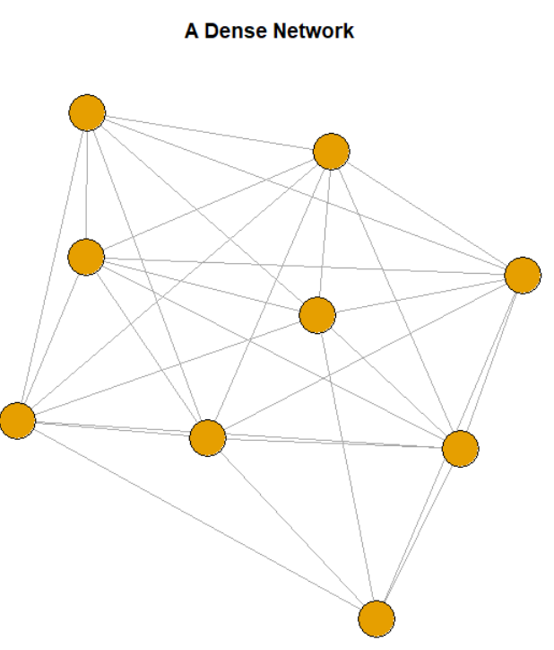
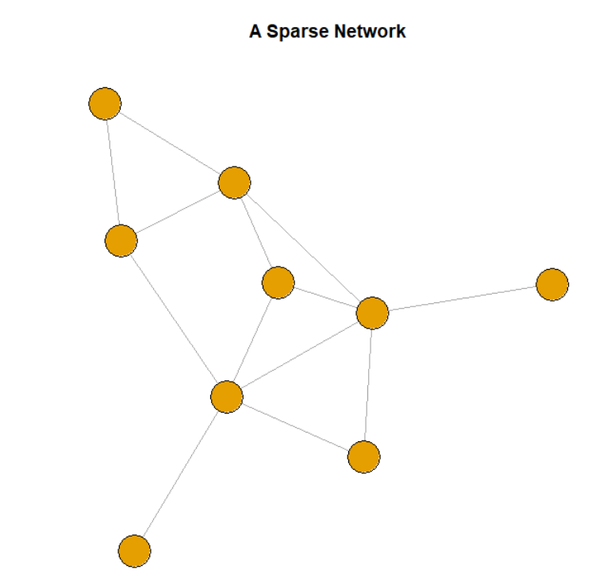
Classroom Density

Slide 76
ELO: Cross-Sectional Study Numbers
Study Year 1 (2016-2017 school year)
  One school district
    Private PreK programs
  79 classrooms in five grades: (Prek – 3rd Grade)
    Attempted to enroll all children in each classroom
  1,142 students with active and passive consent
    80% consent rate
    Used for social network measures
  915 with active consent
    Used for child outcomes
    58% white, 78% speak fluent English, 60% moms have HS degree or less

Slide 77
Quality
Classroom quality rated by the CLASS (Pianta, La Paro, & Hamre, 2008)
Live coded by trained observers, 2 cycles per classroom
Density
Rated per classroom in two ways:
  Students: Viewed a class roster and asked them who they like to play with.
  Teachers: Asked to rate how frequently each pair of students in their class play or work together
Network density generated using SNA package in R (Butts 2016)

Slide 78
Capturing the classroom network
 | Stella | D’Andre | Poppy | Lake | Destiny | Dylan | Serenity
Stella | X | X | X | X | X | X | X
D’Andre | 0 | X | X | X | X | X | X
Poppy | 2 | 0 | X | X | X | X | X
Lake | 0 | 2 | 1 | X | X | X | X
Destiny | 1 | 1 | 1 | 2 | X | X | X
Dylan | 1 | 1 | 0 | 0 | 1 | X | X
Serenity | 1 | 0 | 0 | 1 | 2 | 1 | X

Slide 79
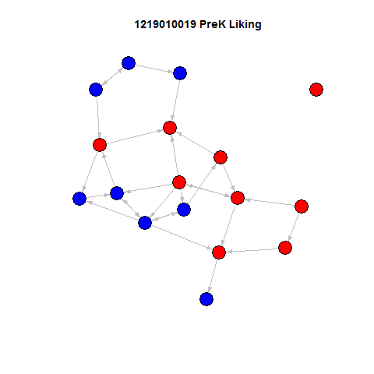
Results: Student Ratings
This is the network of a randomly selected Preschool Classroom
Children were asked: “who do you like to play with the most”
Children with no paths didn’t select anyone and no one selected them.
Bi-directional arrows are reciprocal friendships.
Directional arrows show child A likes to play with child B.
girl
boy

Slide 80
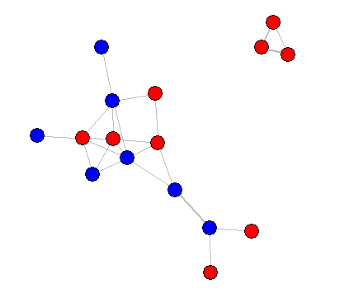
Teacher Ratings
The same Preschool Classroom
Teacher reported who plays and works together
Frequency is collapsed for this analysis:
  A pair of children is rated as either having a tie (1) or not (0).
girl
boy

Slide 81
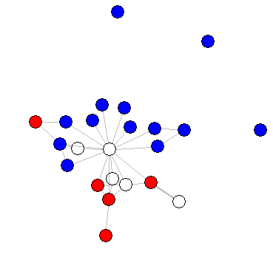
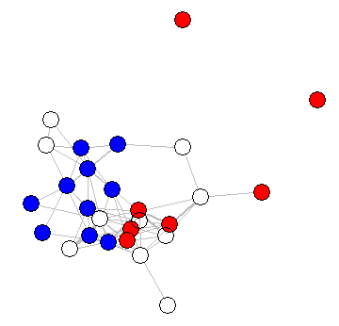
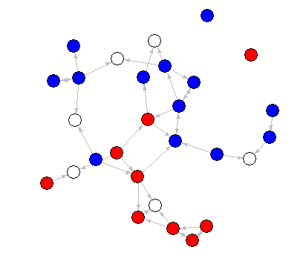
Results: Teacher Ratings of Density
G1
G3
Pre-K
K
No information
On average, density is significantly higher in PreK compared to all other grades.
girl
boy

Slide 82
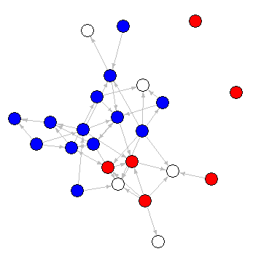
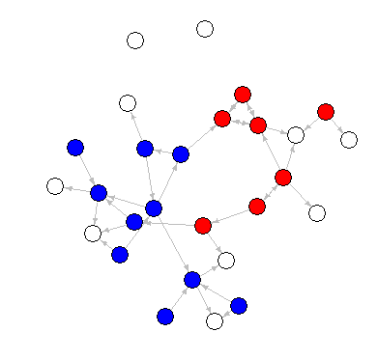
Results: Child Report vs Teacher Report
Pre-K
K
G1
Child
Teacher
No information
girl
boy

Slide 83
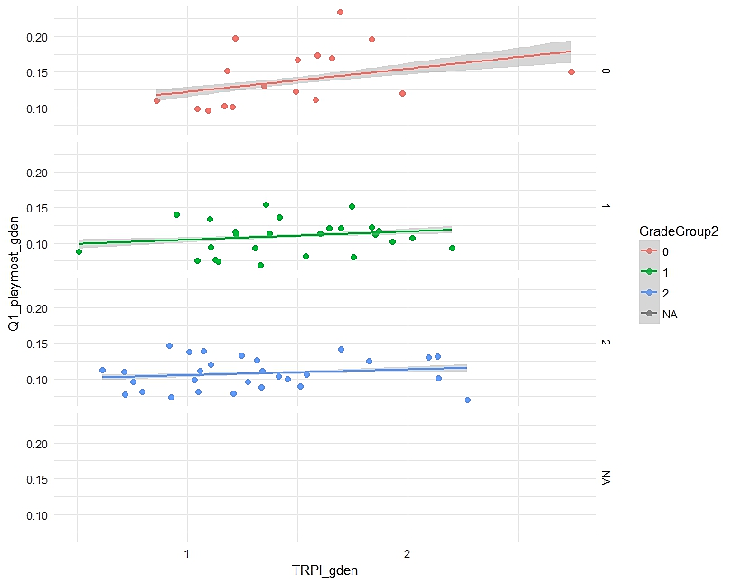
Child Report vs Teacher Report
PreK
Child rated density
K / G1
G2 /G3
Teacher rated density

Slide 84
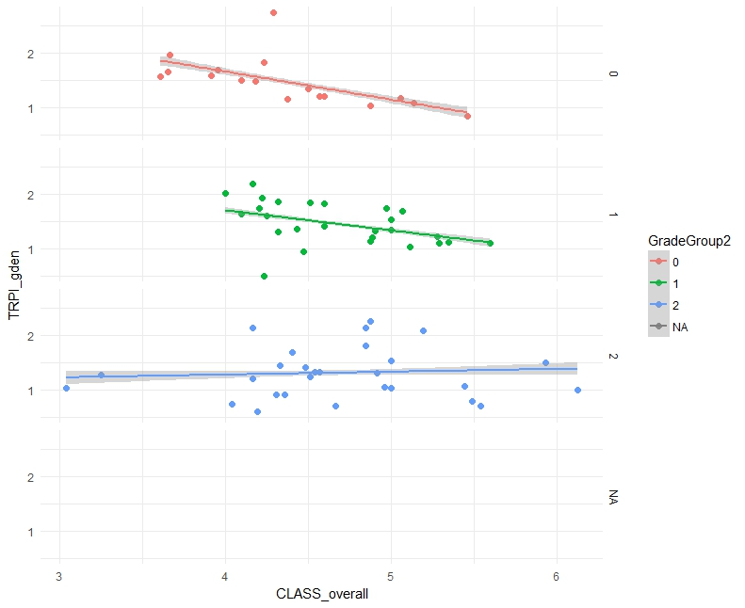
Teacher Report vs CLASS
PreK: r = - .44
K / G1: r = .04
Teacher rated density
G2 /G3: r = .14
CLASS

Slide 85
Predicting Student Outcomes: Model building
HLM models nesting students within classrooms.
Outcomes (raw scores):
  Social Skills, Problem Behaviors: TCRS (Hightower, 1986)
  Vocabulary, Reading, Math: Woodcock Johnson III (Woodcock, McGrew, & Mather, 2007)
Covariates: Pretest, Gender, Age, Grade, Class size
Predictors of interest:
  CLASS composite, Child-rated density, Teacher rated density
  Interaction between pretest and density
  Interaction between CLASS and density

Slide 86
Results: Main Effects
 | SS* | PB* | PV* | LW* | AP*
Intercept | -7.08* | -0.42* | 3.06* | -12.88* | 4.88*
Pretest | 1.03* | 0.88* | 0.74* | 0.88* | 0.78*
CLASS | 0.08* | 0.14* | 0.23* | 1.29* | -0.25*
Child Density | 13.91* | 7.89* | -1.94* | 19.68* | 5.43*
Teacher Density | 3.53* | 0.64* | 0.00* | 1.12* | 0.004
*p < .05, HLMs also included several covariates not pictured here.

Slide 87
Results: Pretest Interaction
 | SS | PB | PV | LW | AP
Intercept | -7.08 | -0.42 | 3.06 | -12.88 | 4.88
Pretest | 1.03* | 0.88* | 0.74* | 0.88* | 0.78*
CLASS | 0.08 | 0.14 | 0.23 | 1.29* | -0.25
Child Density | 13.91 | 7.89 | -1.94 | 19.68 | 5.43
Teacher Density | 3.53* | 0.64 | 0.00 | 1.12 | 0.004
Pretest*Teacher Interaction | -0.14* | -0.01 | -0.02 | 0.02 | -0.07
*p < .05, HLMs also included several covariates not pictured here.
Denser classrooms matter more for children with a low pretest
Q3: Interactions of CLASS with density: None were significantly different from zero.

Slide 88
Conclusions
This is a preliminary look at these data.
  Another 90 classrooms are currently being collected.
  For academic outcomes, will use W-scores (not yet all calculated)
Only one of several proposed network-based predictors
  Classroom hierarchical vs egalitarian
  Norms (social and academic)
Will also examine student-level network information
  Number of ties a child has
  Position within the network
  Victimization
girl
boy

Slide 89
Future Directions
We are also simultaneously conducting a longitudinal study
  240 preschool children
  160 non-preschool attending peers (recruited in K)
Does the classroom ecology look different for students who attended PreK and those who did not?
Does the classroom ecology play a special role in students’ transitions to Kindergarten?

Slide 90
Thank you!
Pre-K
K
G1

