Slide 1
Early Learning Network
Year 1 Results:
Preschool Educational Practices and Child Outcomes
The Early Learning Network is funded by the Institute of Education Sciences.
National Research Conference on Early Childhood
June 27, 2018
  @earlylearnnet

Slide 2
The Early Learning Network aims to advance the understanding of policies and practices that narrow the achievement gap and maintain early learning success as children transition from preschool to elementary school and beyond.

Slide 3

♦ Five Research Teams
♦ One Assessment Team
♦ Network Lead

Slide 4
Complementary Research Studies
Descriptive study:
  Identify systems-level policies and practices that support early learning
Classroom observation study:
  Identify teaching practices and other classroom-level malleable factors associated with children’s school readiness and achievement in preschool and early elementary school
Longitudinal study:
  Identify malleable factors associated with early learning and school achievement over time from preschool through the early elementary school grades

Slide 5
Symposium Agenda
Chair: Susan Sheridan, ELN Lead (University of Nebraska-Lincoln)
Paper 1: How Does Quality of Curricular Implementation Support Diverse Children’s Skills in Prekindergarten?: Evidence from Boston
  JoAnn Hsueh, Meghan McCormick, Michelle Maier, Christina Weiland, Jason Sachs, Catherine Snow (MDRC & Partners)
Paper 2: Pre-K classroom Characteristics and Pre-K Gains of Children Living in Rural Areas
  Peg Burchinal, Irina Mokrova, Mary Bratsch-Hines, Ellen Peisner-Feinberg (UNC)
Paper 3: Classroom quality and classroom network structure: Interplay and prediction of student outcomes
  Jessica Logan, Jing Chen, Laura Justice, Tzu-Jung Lin, Kelly Purtell (OSU)
Paper 4: Understanding the Effects of Classroom Processes on Child Outcomes in Pre-kindergarten
  Bob Pianta, Ginny Vitiello, Jessica Whittaker, Erik Ruzek, Tara Hofkens & Arya Ansari (UVA)
Discussant: Sara Vecchiotti, Foundation for Child Development

Slide 6
How Does Quality of Curricular Implementation Support Diverse Children’s Skills in Prekindergarten?:
Evidence from Boston
JoAnn Hsueh
Meghan McCormick
Michelle Maier
Christina Weiland
Jason Sachs
Catherine Snow
June 27, 2018
National Research Conference on Early Childhood

Slide 7
The BPS Model as a Case Study for Examining Fidelity of Implementation
Curriculum in place | Example components adapted from OWL | Example Building Blocks components | Example district-developed components
Focus on K1 (district-adapted version of Opening the World of Learning & Building Blocks). Thematic curriculum that cuts across ELA, math, science, social study, and arts. | Centers & Introduction to Centers | Building Blocks centers | Thinking & feedback; SWPL; Let’s Find Out About It
 | Read Aloud | Building Blocks whole group activities | Storytelling
 | Small Groups to support language/literacy | Building Blocks small group activities | Storyacting

Slide 8
Research questions
What does fidelity look like across prekindergarten public school classrooms in BPS?
What measures of fidelity are most closely associated with CLASS?
Is fidelity to the BPS PreK model associated with children’s language and math scores in the Spring of PreK?
  For which groups of students does fidelity appear most predictive of Spring outcomes (e.g., dual language learners, racial/ethnic minority students)?

Slide 9
Research & BPS teams Co-construct Tool to Measure Fidelity of Implementation
Research team conducts in-depth curriculum review and meets with BPS staff
Further edits and adaptation following field-based piloting with BPS staff
Training and reliability procedures take into account BPS staff feedback
Research team develops fidelity tool and iteratively edits it following meetings with BPS staff
BPS instructional coaches collect data in classrooms

Slide 10
Fidelity Data in Public School Classrooms
N = 41 classrooms in 20 schools
41 total public prekindergarten classrooms participated (97% of teachers in participating schools)
Classrooms observed 2x
Each classroom observed on two separate days for 2 – 3 hours/obs. Observation data averaged across days.
Reliability
20% of observational visits were coded by two BPS coaches; Reliability analysis suggests high agreement.

Slide 11
Classroom & teacher participants
(N = 41 public school classrooms across 20 schools)
Teacher characteristic | %age/Mean
Teacher age | 43.95 (SD = 9.37)
Years teaching | 14.79 (SD = 9.25)
Years teaching prekindergarten | 8.6 (SD = 7.37)
Years teaching at current school | 7.79 (SD = 8.01)
Teacher has master’s degree | 90%
Teacher female | 100%
Teacher Black | 22%
Teacher White | 49%
Teacher Hispanic | 13%
Teacher Asian or other race | 16%
Classrooms per school | 1.35 (SD = .42)

Slide 12
Summary of Fidelity Data for BPS K1 Classrooms
Component | % classrooms component observed
Centers | 100%
Intro to Centers | 95%
Read Aloud | 93%
SWPL | 80%
Building Blocks Whole Group | 66%
Small Group, Language/Literacy | 63%
Building Blocks Centers | 49%
Building Blocks Small Group | 41%
Thinking & Feedback | 32%
Storytelling | 15%
Story-acting | 12%
Let’s Find Out About it | 7%

Slide 13
Cross-component fidelity measures
Vocabulary
(α = .91)
Extending/Building
(α = .91)
Summary/ Reflection/Making Connections
(α = .79)
Scaffolding/ Differentiation
(α = .82)

Slide 14
What does fidelity look like overall in BPS public school prekindergarten classrooms?

Slide 15
How does this compare to CLASS scores?

Slide 16
How do fidelity measures relate with CLASS?
 | Instructional support | Emotional support | Classroom org.
Instructional support | 1.0
Emotional support | .67 | 1.0
Classroom org. | .69 | .85 | 1.0
Extending/Building | .18 | .16 | .10
Summary/Reflection | .22 | .10 | .14
Vocabulary | .01 | .01 | -.07
Scaffolding/Differentiation | .35 | .21 | .22

Slide 17
How does implementation vary depending on classroom composition?
There are some differences in implementation between classrooms. On average:
  Classrooms with higher percentages of white students have higher quality of implementation
  Classrooms with higher percentages of black and Hispanic students have lower quality of implementation
  Classrooms with higher percentages of DLLs have similar quality of implementation as classrooms with fewer DLLs, but more variation across classrooms.

Slide 18
Links between fidelity of implementation and improvements in language and math across prekindergarten year
Full sample of students - no significant associations between cross-component fidelity measures and gains in language or math across prekindergarten year
No significant associations detected in this preliminary work using cross-component fidelity constructs to predict PPVT outcomes
Statistically significant interactions between fidelity of implementation, Hispanic and DLL status, and math outcome

Slide 19
Example of Predicted Math Skills for Hispanic Students at End of Prekindergarten Year

Slide 20
Example of Predicted Math Skills for White Students at End of Prekindergarten Year

Slide 21
Example of Predicted Math Skills for Dual Language Learner Students at End of Prekindergarten Year

Slide 22
Some preliminary conclusions
Reliable fidelity data can be collected by district staff.
Systematic variation in fidelity across classrooms.
Fidelity may predict math outcomes (on a small magnitude) but story is likely in the subgroups for a diverse sample with varying skill levels at baseline and follow-up.

Slide 23
Limitations & Next Steps
Work is very preliminary and in early stages
  Future models will include more rigorous work to determine covariates and alternative model fits.
More measurement work needed to operationalize fidelity constructs and consider any within-component measures of adherence, dosage, quality
Data are correlational across one school year
Sample is fairly small in Year 1 study (particularly for subgroups); future years will include larger samples for subgroup examination

Slide 24
Acknowledgments
MDRC
Marissa Strassberger
Rama Hagos
Sharon Huang
Jared Smith
Desiree Alderson
Ilana Blum
Kelly Terlizzi
Mirjana Pralica
BPS
Brian Gold
Abby Morales
Marina Boni
Melissa Luc
David Ramsey
BPS Dept. of Early Childhood Staff
University of Michigan
Deborah Ball
Lillie Moffett
Paola Rosado
Amanda Ketner
Harvard
Nonie Lesaux
Sibyl Holland
Maia Gokhale
Data collection team

Slide 25
Funding Acknowledgment
The research reported here was supported by the Institute of Education Sciences, Department of Education, through Grant R305N160018 – 17 to MDRC.
The opinions expressed are those of the authors and do not represent views of the Institute or U.S. Department of Education.

Slide 26
Questions?
JoAnn Hsueh
MDRC
joann.hsueh@mdrc.org
Meghan McCormick
MDRC
meghan.mccormick@mdrc.org
Michelle Maier
MDRC
meghan.mccormick@mdrc.org
Christina Weiland
University of Michigan
weilandc@umich.edu
Jason Sachs
Boston Public Schools
jsachs@bostonpublicschools.org
Catherine Snow
Harvard Graduate School of Education
Catherine_snow@gse.harvard.edu

Slide 27
Pre-K classroom characteristics and Pre-K gains of children living in rural areas
Peg Burchinal
Irina Mokrova
Mary Bratsch-Hines
Ellen Peisner-Feinberg
University of North Carolina at Chapel Hill

Slide 28
Educational practices and child outcomes in Pre-K
ECE can reduce achievement gap
State and federal preschool programs
But – questions remain:
  Which child outcomes are promoted by which aspects of preschool ECE?

Slide 29
ECE quality dimensions
Process quality
  Teacher sensitivity and classroom management relate to socio-emotional outcomes,
  Widely examined; modest associations
Verbal interactions with adults
  T-C conversations relate to language
  Verbal literacy instruction relate to literacy skills
  Less widely examined; modest associations

Slide 30
ECE quality dimensions
Instruction time
  More time in content area relates to gains in that skill
  Less widely studied: modest associations
Setting
  Small groups help young children learn
  Centers provide children with hands-on learning opportunities: Cornerstone of ECE instruction
Curriculum
    Wide-scale belief in whole child curricula
    Moderate to strong evidence for some domain-specific curricula

Slide 31
Design and participants
Cohort study of rural NC
  6 NC rural counties
  63 randomly selected NC Pre-K classrooms
Pre-K children
  351randomly selected children
    34% Spanish-English dual language learners
ECE dimensions
  Classroom observations
  Teacher report of curriculum

Slide 32
Quality measures
Classroom observed
Day 1
  CLASS
  High quality instructional practices – adapted Boston pre-K “fidelity” checklist
  Combined – alpha =.90
Day 2
  Language Interaction Snapshot (LISn)- summarized for classroom
    Time sampling observations of individual children
      30 second recording of language exchanges
      5 minute recording of setting and activity
      4-6 cycles for 6 or more children

Slide 33
ECE Dimensions

Slide 34
ECE Dimensions:
Teacher Talk and Instructional Time

Slide 35
ECE Dimensions: Curriculum

Slide 36
ECE Dimensions
 | N | % Mean | Sd
High Quality Practices | 62 | 4.17 | 0.66
Teachers: complex language | 61 | 0.04 | 0.03
Instructional Time Literacy Activities | 61 | 0.23 | 0.12
Phonics Activities | 61 | 0.05 | 0.05
Math Activities | 61 | 0.16 | 0.13
Grouping – Small Group | 61 | 0.08 | 0.11
Whole Group | 61 | 0.36 | 0.18
Free Choice/Center | 61 | 0.48 | 0.19
Creative Curriculum | 59 | 78%

Slide 37
Correlations among Quality Dimensions
 | Process Quality | Complexconver-sation | Literacy Activities | Sounds Activities | Math Activities | Small Group | Whole Group | Creative Curric.
Process quality |  | .27* | .16 | -.04 | .13 | -.10 | .25* | .20
Complexconver-sation |  |  | .34** | .24+ | .47*** | .35** | .07 | -.18
Literacy Activities |  |  |  | .63*** | .05 | .01 | .21+ | -.24+
Sounds Activities |  |  |  |  | .12 | .00 | .05 | -.37**
Math Activities |  |  |  |  |  | .50*** | .06 | -.34**
Small group |  |  |  |  |  |  | -.27* | -.24+
Whole group |  |  |  |  |  |  |  | -.13

Slide 38
Child outcomes
Collected fall and spring
Measures
  Expressive One Word Picture Vocabulary
  Woodcock Johnson III
    Letter Word
    Applied Problems
  DIBELS
    First Sound Fluency
    Phonemic Segmentation Fluency
  NIH Tool Box
    Flankers (inhibitory control)
    Dimensional Card Sort (cognitive flexibility)

Slide 39
Pre-K Child Outcomes
***
***
*

Slide 40
Gains in Child Outcomes-raw or W scores
 | N | Mean | SD
Expressive One Word | 345 | 7.14* | 11.93
WJ3 Letter Word Identification | 352 | 21.05*** | 19.73
DIBELS First Sound Fluency | 351 | 3.86* | 8.96
DIBELS-Phonemic Segmentation | 350 | 2.89* | 8.39
WJ3 Applied Problems | 352 | 18.66*** | 18.71
NIH Tool Box-EF: Flanker | 341 | 8.74* | 13.18
NIH Tool Box-EF: Dimensional Card Sort | 332 | 7.00* | 15.89

Slide 41
HLMs:
Gain scores analyzed
Model
  Level 1: Y_{ijk} = d_{ojk}+ d_{1jk} <child covariates> + e_{ijk}
  Level 2: d_{ojk} = B_{o} + B₁ High Quality Practices_{jk} +
  B₂ T Complex Language_{jk} + B₃ Content Activities_{jk} +
  B₄ Small Group_{jk} + B₅ Whole Group_{jk} +
  B₆ Creative Curriculum_{jk} + e_{jk}
Backwards elimination to check findings

Slide 42
HLM Results
 | Language EOW | Literacy WJ LW | Letters DIBELS FSF | Phonemic DIBELS PSF | Math WJ AP | EF Flankers | EF Card Sort
Process Quality |  | .19** |  |  |  | -.14**
Complex Conversation
Instruction: Literacy Sounds Math | .21* |  | .16**
Small Group
Whole Group | -.17* |  |  |  | -.12*
Creative curriculum |  | -.17** |  | -.17**

Slide 43
Conclusions
Surprisingly sparse findings
  No one ECE dimension predicted all outcomes
  Best predictors
    Instructional time: positively related to gains in language and specific literacy skills
    Whole group: negatively related to gains in language and math
    Curriculum: negatively related to gains in literacy
    Process quality: mixed, positive gains-decoding, negative gains – inhibitory control

Slide 44
Conclusions
May need attend to
  Other ECE dimension in addition to process quality
  Measures of individual child experiences as well as measures of teachers
Different predictors for different outcomes –
  need to be strategic in what ECE dimenions should be promoted for specific child outcomes

Slide 45
Our appreciation
To all participating families, teachers, and school administrators
To all research assistants and project staff
To the Institute of Education Sciences

Slide 46
Thank You
burchinal@unc.edu

Slide 47

Classroom quality and classroom network structure:
Interplay and prediction of student outcomes
Jessica Logan, Jing Chen, Laura Justice, Tzu-Jung Lin, Kelly Purtell
The Ohio State University
NRCEC
6/27/2018

Slide 48
Early Learning Ohio Team
Principal Investigator:
Dr. Laura Justice
Co-Investigators:
Dr. Tzu-Jung Lin
Dr. Jessica Logan
Dr. Kelly Purtell
Key Project Staff:
Jennifer Bostic
Allie Hamilton
Janelle Williamson
Katie Filibeck
Lauren Barnes
Anna Rhoad-Drogalis
Hui Jiang
Jing Chen

Slide 49
Early Learning Ohio
Broad goal: Expand our understanding of classroom ecology
A comprehensive examination of the classroom ecology and its relations with children’s learning PreK – grade three.

Slide 50
Classroom Network
Children’s language and social skills are shaped by who is around them
  Complexity of teacher talk (e.g., Justice et al., 2013)
  The skills of their peers (e.g., Justice, Logan, Lin, & Kaderavek, 2016)
Classroom social networks directly measure who children spend time with, and can be characterized
Children’s academic growth is likely affected by both classroom quality and the nature of the social network created by their peers (Gest et al., 2014)
Children’s language is significantly predictive of classroom density in preschool (Chen et al., 2017).
  Higher language scores → more dense classrooms

Slide 51
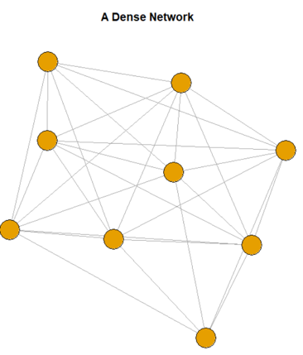
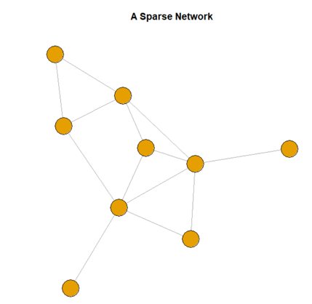
Classroom Density
(observed ties / possible ties)

Slide 52
Research Questions
Is classroom density predictive of children’s gains in academic and social skills?
Is density more important for children of different skill levels?
Interactions with classroom quality

Slide 53
ELO: Cross-Sectional Study Numbers
Study Year 1 (2016-2017 school year)
  One school district
    Some Head Start, some private PreK programs
  79 classrooms in five grades: (Prek – 3rd Grade)
    Attempted to enroll all children in each classroom
  1,142 students with active and passive consent
    80% consent rate
    Used for social network measures
  915 with active consent
    Used for child outcomes
    58% white, 78% speak fluent English, 60% moms have HS degree or less

Slide 54
Density
Network density generated using SNA package in R (Butts 2016)
Rated per classroom in two ways:
  Students: Viewed a class roster and asked them who they like to play with.
  Teachers: Asked to rate how frequently each pair of students in their class play or work together
Before I get to research questions – want to show you the data in depth

Slide 55
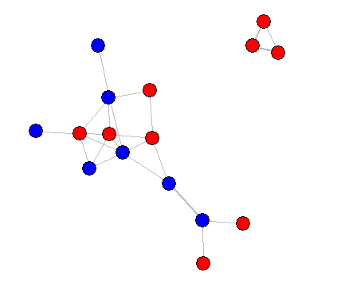
Teacher Ratings of Classroom Density
A randomly selected preschool Classroom
Teacher reported who plays and works together
A pair of children is rated as either playing and working together (1) or not (0).
girl
boy

Slide 56
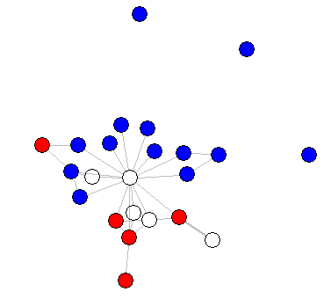
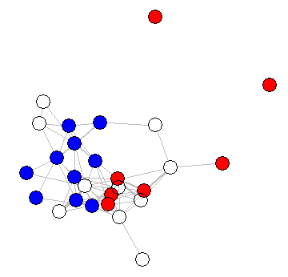
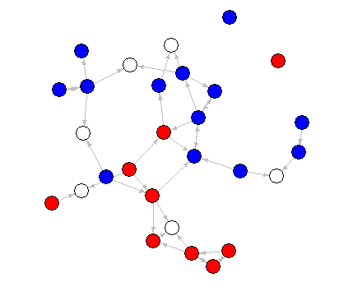
Results: Teacher Ratings of Density
G1
G3
Pre-K
K
No information
girl
boy

Slide 57
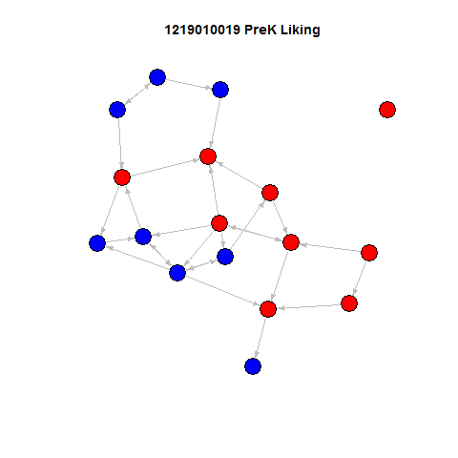
Results: Student Ratings of density
The same preschool classroom
Children were asked: “who do you like to play with the most”
Children with no paths didn’t select anyone and no one selected them.
Bi-directional arrows are reciprocal friendships.
Directional arrows show child A likes to play with child B.
girl
boy

Slide 58
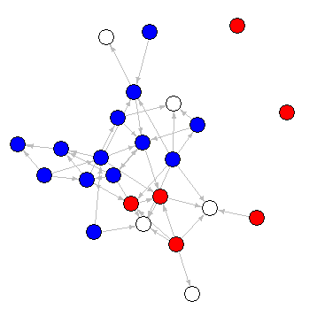
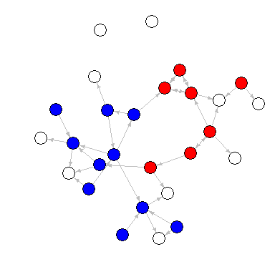
Results: Child Report vs Teacher Report
Pre-K
K
G1
Child
Teacher
No information
girl
boy

Slide 59
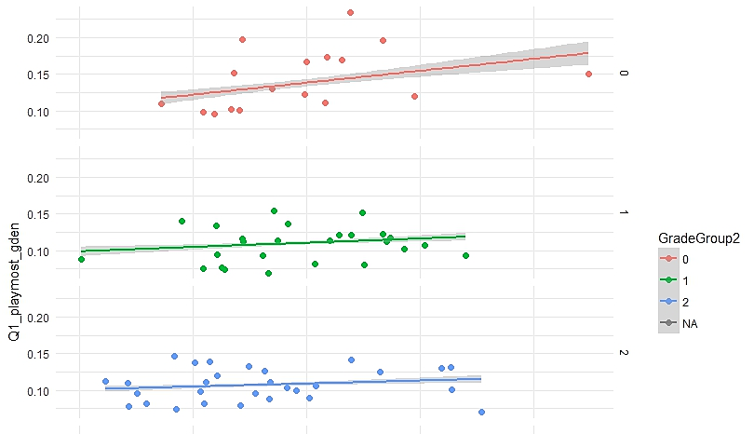
Variability : Child Report vs Teacher Report
PreK
PreK: r = .22
Child rated density
K / G1 = .15
G2 /G3 = .11
Teacher rated density

Slide 60
Predicting Student Outcomes: Model building
HLM models nesting students within classrooms.
Outcomes:
  Social Skills, Problem Behaviors: TCRS (Hightower, 1986): Raw Scores
  Vocabulary, Reading, Math: Woodcock Johnson III (Woodcock, McGrew, & Mather, 2007): W Scores
Covariates: Pretest, Gender, Age, Grade, Class size
Predictors of interest:
  CLASS composite, Child-rated density, Teacher rated density
  Interaction between pretest and density
  Interaction between CLASS and density

Slide 61
Results: Main Effects
 | SS* | BC* | PV* | LW* | AP*
Intercept | -0.06* | -0.01* | 0.32* | 0.19* | 0.37*
Pretest | 0.78* | 0.79* | 0.67* | 0.77* | 0.67*
CLASS | 0.00* | 0.00* | 0.02* | 0.01* | 0.01*
Child Density | 0.06* | 0.03* | -0.01* | 0.00* | 5.43*
Teacher Density | 0.16* | 0.05* | 0.00* | 0.01* | -0.01*
*p < .05, HLMs also included several covariates not pictured here.
Standardized estimates

Slide 62
Results: Pretest Interaction
 | SS | BC* | PVz | LWz | Apz
Intercept | -0.05z | 0.01* | 0.33* | 0.23z | 0.38z
Pretest | 0.77* | 0.79* | 0.68* | 0.67* | 0.66*
CLASS | 0.00z | 0.00* | 0.02* | 0.01z | -0.01z
Child Density | 0.05z | -0.01* | -0.01* | 0.01z | 0.01z
Teacher Density | 0.17* | 0.05* | -0.00* | 0.01z | 0.01z
Pretest*Teacher Interaction | -0.07* | 0.00* | -0.02* | -0.01z | -0.03*
*p < .05, HLMs also included several covariates not pictured here.
Denser classrooms matter more for children with a low pretest on Social Skills and Applied Problems
Q3: Interactions of CLASS with density: None were significantly different from zero.

Slide 63
Social Skills interaction

Slide 64
Conclusions
This is a preliminary look at these data.
  Data being cleaned on another ~100 classrooms
Will also examine student-level network information
  Number of ties a child has
  Position within the network
  Experiences with victimization
girl
boy

Slide 65
Thank you!
Logan.251@osu.edu
Pre-K
K
G1

Slide 66

Understanding the effects of classroom processes
on child outcomes in pre-kindergarten
Ginny Vitiello
June 27, 2018

Slide 67
Research Team
Robert Pianta
Jessica Whittaker
Ginny Vitiello
Erik Ruzek
Marcia Kraft-Sayer
Brittany Kerr
Laura Helferstay
Marianna Lyulchenko
Arya Ansari
Tara Hofkens
Partners: School district, IES, ELN

Slide 68
Preschool and Fade-Out
Record enrollment in public preschool
Produce measurable advantages
Quality is variable

Slide 69
What are the active ingredients?
Why does fade-out (or catch up) occur?

Slide 70
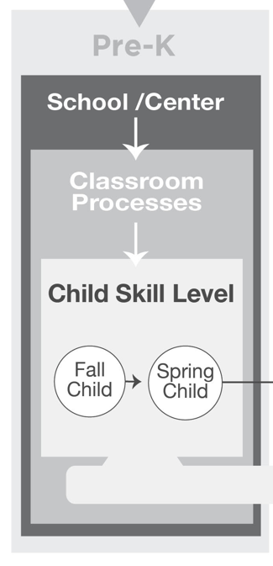

Slide 71
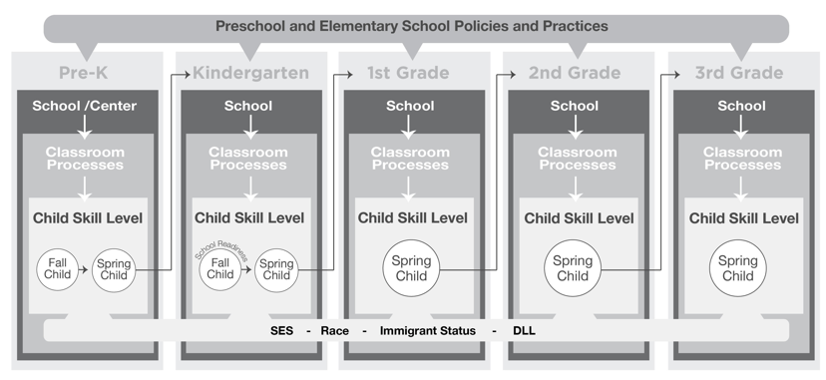

Slide 72
Longitudinal Cohort Study
Pre-K Attenders
Non-Attenders
Pre-K | K | 1st | 2nd | 3rd

Slide 74
Research Question
How are classroom process variables
associated with children’s gains
within preschool?

Slide 75
Study Context & Participants

Slide 76
Auspice

Slide 77
Children’s Race/Ethnicity

Slide 78
Primary Language Spoken at Home
English
Spanish

Slide 79
Multi-Lingual Classrooms
72%
have children who speak 3+ languages

Slide 80
Measures & Procedures

Slide 81
Classroom
Processes
Teacher-Child Interactions
Time Use
Content of Instruction
CLASS
Survey - Rigor
Time on Academics, SEL
Teacher Structured, Routines

Slide 82
Classroom Process Data
2-3 days of classroom observation
  CLASS (teacher-child interactions)
  Behavioral Coding System (use of class time)
Teacher questionnaire adapted from ECLS-K
  Literacy content coverage
  Math content coverage

Slide 83
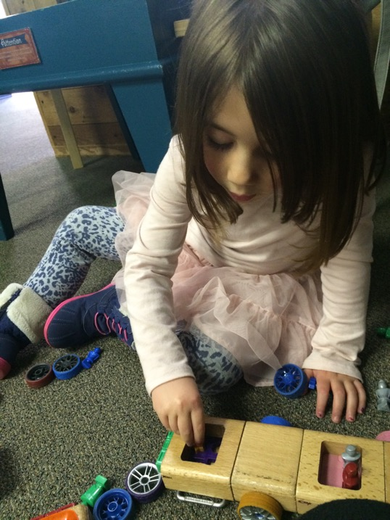
Child
Assessments
Executive Functions
Literacy
Teacher-Child Relationships
Math
Social-Emotional

Slide 84
Child Assessments
Literacy and Math: Woodcock-Johnson III
  Letter-Word ID
  Picture Vocabulary
  Applied Problems
  Quantitative Concepts
Executive Functions
  Head-Shoulders-Knees-Toes Task
  Pencil Tap
  Backwards Digit Span
Social-Emotional Skills: STRS & TCRS teacher ratings
  Teacher-child conflict
  Teacher-child closeness
  Social Skills
  Conduct Problems

Slide 85
Analyses
Hierarchical linear models (nesting students in classrooms)
Models control for:
- Baseline measure of each outcome in the fall
Student characteristics (gender, age, race/ethnicity, SES, language)
Classroom characteristics (aggregated student gender, age, race/ethnicity, income, special needs,
Teacher characteristics (race, education, experience, beliefs about children)
Program type

Slide 86
Results

Slide 87
Academic Skills
 |  | Letter-Word |  |  | Picture Vocab |  |  | Applied Problem |  |  | Quant. Concepts
 |  | Estimate | p | S.E. | Estimate | p | S.E. | Estimate | p | S.E. | Estimate | p | S.E.
Fall Pretest |  | .714 | *** | .028 | .759 | *** | .026 | .680 | *** | .022 | .706 | *** | .016
Teacher-Child Interactions | Overall Quality |  |  |  |  |  |  |  |  |  | .418 | ** | .146
Content Dosage | Proportion Academics | .254 | * | .135
 | Proportion SEL
Activity Setting | Proportion Teacher-Structured | .376 | ** | .134 |  |  |  |  |  |  | .338 | * | .153
 | Proportion Routines | .354 | ** | .138 |  |  |  |  |  |  | .385 | * | .178
Rigor | Literacy Level
 | Math Level
*p<.10, **p<.05, ***p<.01

Slide 88
Executive Function Skills
 |  | Backward Digit Span |  |  | HTKS |  |  | Pemcil Tap
 |  | Estimate | p | S.E. | Estimate | p | S.E. | Estimate | p | S.E.
Fall Pretest |  | .200 |  | .152 | .579 | *** | .092 | .644 | *** | .094
Teacher-Child Interactions | Overall Quality | .334 | * | .154
Content Dosage | Proportion Academics
 | Proportion SEL
Activity Setting | Proportion Teacher-Structured
 | Proportion Routines
Rigor | Literacy Level
 | Math Level
*p<.10, **p<.05, ***p<.01

Slide 89
Teacher-Child Relationships
 |  | Closeness |  |  | Conflict
 |  | Estimate | p | S.E. | Estimate | p | S.E.
Fall Pretest |  | .675 | *** | .026 | .715 | *** | .020
Teacher-Child Interactions | Overall Quality |  |  |  | -0.38 | ** | 0.11
Content Dosage | Proportion Academics
 | Proportion SEL
Activity Setting | Proportion Teacher-Structured
 | Proportion Routines
Rigor | Literacy Level
 | Math Level
*p<.10, **p<.05, ***p<.01

Slide 90
Social and Emotional Skills
 |  | Task Orientation |  |  | Social Skills |  |  | Conduct Problems
 |  | Estimate | p | S.E. | Estimate | p | S.E. | Estimate | p | S.E.
Fall Pretest |  | .726 | *** | .018 | .714 | *** | .025 | .728 | *** | .023
Teacher-Child Interactions | Overall Quality
Content Dosage | Proportion Academics
 | Proportion SEL
Activity Setting | Proportion Teacher-Structured | -.241 | * | .118
 | Proportion Routines
Rigor | Literacy Level |  |  |  |  |  |  | -.263 | * | .133
 | Math Level |  |  |  | .281 | * | .122
*p<.10, **p<.05, ***p<.01

Slide 91
Note:
Very little variance in academic gains
  0 – 3.4%
Classrooms made gains, but at similar rates

Slide 92
Conclusions
Some early evidence that exposures to effective teacher-child interaction and educational content and structured setting promote greater performance in EF and academic skills
Focus on examining moderated effects
In Kindergarten, increase observation of child experience

